Slide 1

HOPE STUDY PRODUCT TRAINING
PHASE 2
Cindy Jacobson, PharmD

Slide 2
Overview
Review Ring Resupply and Holds
Product Considerations Split/Missed/Off-site visits
Ring Collection Procedures and Accountability Documentation

Slide 3
VR DISPENSING REMINDERS
Dispensing takes place on the day of enrollment and each scheduled follow-up visit (except PUEV and Termination)
During the monthly visits, the decision to dispense >1 ring is up to the IoR and must be documented fully
During the quarterly phase 3 rings will be provided (maximum dispensed = 3 rings)
If >3 needed ppt needs to return during the quarter for additional ring at IoR discretion

Slide 4
VR DISPENSING
Participant has the option to return monthly, preference is documented on the prescription
● This is NOT expected to be the
“norm”
● These visits should be “fast-tracked”

Slide 5
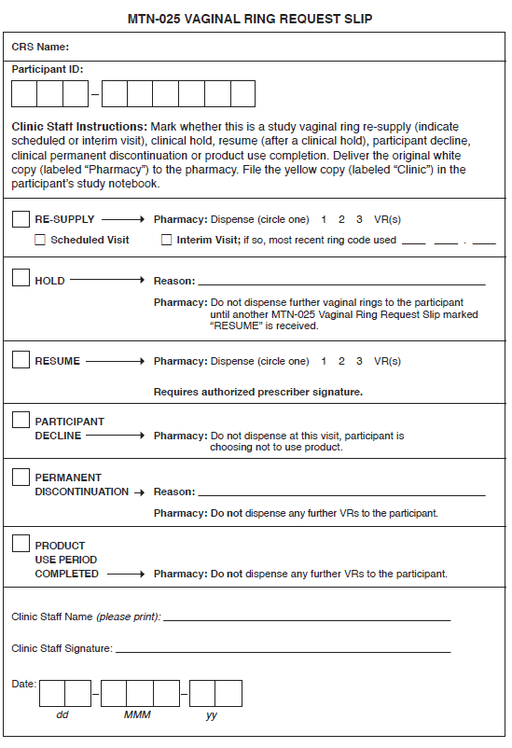
Notes:
This is what the entire form looks like but the next few slides will focus on specific sections.
Will highlight only used if a prescription has ever previously sent.

Slide 6
Product Hold
Study product use may be temporarily held at the request of the clinician during a visit, at an off-site visit or over the phone
MTN-025 Vaginal Ring Request Slip marked HOLD should be completed and sent to pharmacy
  Only completed in the event a participant has ever had a prescription completed (i.e. the slip is not required for participants who have never accepted a study ring)
Clinical Product Hold/Discontinuation Log CRF should also be completed and submitted to SCHARP
● This CRF should be completed for each clinical product hold, even if
the participant is already on a product hold for another clinical reason
Clinical product holds should be documented on clinic documents and CRFs regardless of whether a participant has ever accepted study product (i.e., complete this documentation for all participants, both acceptors and non-acceptors).

Slide 7
Product Hold
A ring should not be removed for a hold and later reinserted for reuse.
Once an MTN-025 Vaginal Ring Request Slip is completed and a “HOLD” is marked, regardless of the reason or duration, no further vaginal rings will be dispensed for that participant until another slip is marked “RESUME” and signed by an authorized prescriber.

Slide 8
Product Hold
Product must be retrieved within 5 working days for product hold due to pregnancy or permanent discontinuation for any other reason or IoR discretion
Product must be retrieved within 7 working days if held for reasons other than pregnancy with expected duration of more than 7 days

Slide 9
Study Product Considerations During
Split Visits
When follow-up visit procedures are split over more than 1 day, safety evaluations for product dispensation (SSP 9.5) should be on first day
Product dispensation on first day
IoR or designee should determine if a new ring should be provided to participant at that visit if safety testing is not complete

Slide 10
Study Product Considerations During
Missed Visits
If a participant misses or is late for a visit, staff need to determine if ppt has an extra ring
If ring is needed then consider options:
Facilitated on-site visit (i.e., transportation provided)
for full visit or minimum safety testing
OR
Off-site visit

Slide 11
Study Product Considerations During
Off-Site Visits
Guidance in SSP 6.4.5
Must have site Off-Site Visit SOP and specify product related procedures for re-supply
Procedures and timeframes for collecting study products, returning study products, and completing all required documentation should be agreed upon by pharmacy and clinic staff and specified in relevant MTN-025 SOPs.
Need to complete Request Slip for pharmacy in advance of the visit, product not released until time of the visit

Slide 12
Study Product Considerations During
Off-Site Visits
Follow all dispensing procedures /documentation (Record of Receipt)
Complete off-site visit log to document transport of product
Previously dispensed product should be collected
During transport, study products should be stored securely (e.g., in a locked vehicle), with access limited to authorized clinic staff.
Temperature should be controlled to the extent possible during transport. Site SOPs should outline steps that will be taken to document that the temperature during transport was maintained at 20 º- 25 º C with allowable excursion between 15º-30ºC.
Temperatures experienced during transport must be documented on the Off-site Visit Log (notify RPh if excursion)
Clinic staff will complete the third, fourth, and fifth columns of the MTN-025 Off-site Visit Log and will return the completed log to the pharmacy and form is retained in pharmacy

Slide 13
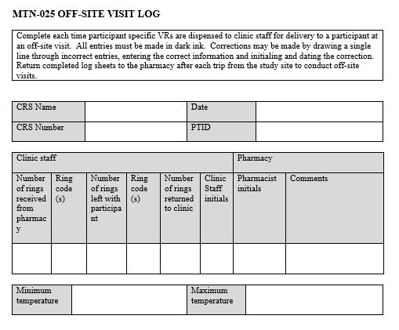
Off-Site Visit Log

Slide 14
Documentation of Clinic Accountability:
Vaginal Ring Provision and Destruction
1. Participant-Specific Clinic Ring
Accountability Log
    Maintain and complete as outlined in Clinic SOP for Study Product Accountability and Destruction
    SOP outlines who is responsible for updating the log and when, where it is stored and QC process
2. Ring Collection/Insertion CRF
3. Ring Tracking Log CRF

Slide 15
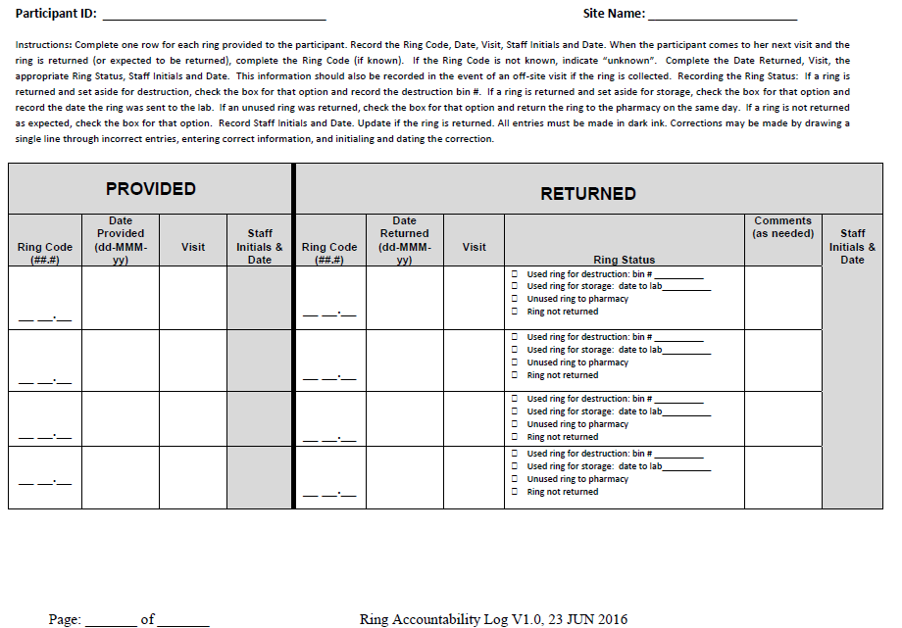
MTN-025 Clinic Participant-Specific Ring Accountability Log
Notes:
As previously mentioned, this log must remain in the clinic and is used to document providing a ring to the participant as well as the return of that ring.

Slide 16
Documentation of Clinic Accountability
1. Clinic Participant-Specific Ring Accountability Log*
2. Ring Collection/Insertion CRF* and
3. Ring Tracking Log CRF
● Completed to document all VR provisions and returns
● Used to document returns as well as accountability
log described above
● After documentation complete, ring(s) stored as per
SSP and site SOP for clinic accountability
* In the unusual event that a ring was dispensed but never inserted, the returned (unused) VR must be returned to the clinic and documented by study staff on the Ring Collection/Insertion and Vaginal Ring Tracking Log CRFs and the Clinic Ring Accountability Log. Unused ring may be returned to pharmacy for quarantine.

Slide 17
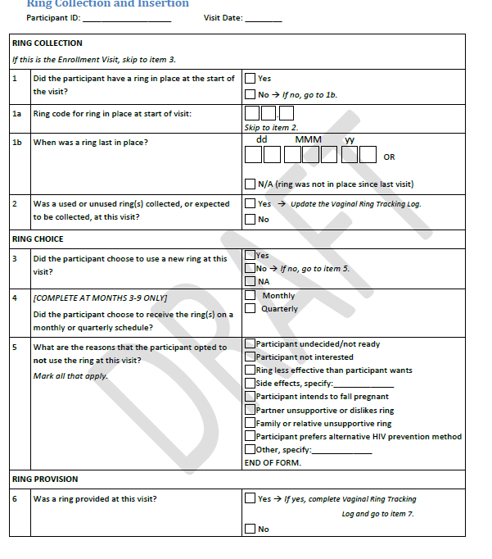
Ring Collection/Insertion CRF

Slide 18
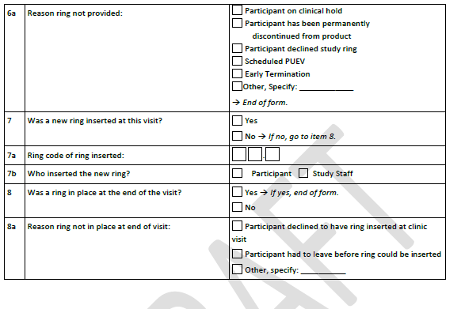
Ring Collection/Insertion CRF (page 2)

Slide 19
Documentation of Clinic Accountability
1. Clinic Participant-Specific Ring
Accountability Log
2. Ring Collection/Insertion CRF
3. Ring Tracking Log CRF

Slide 20
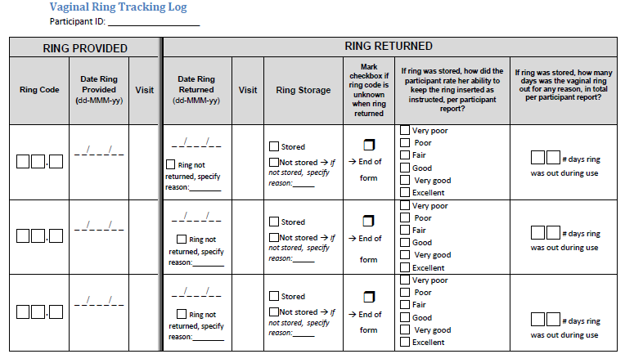

Slide 21
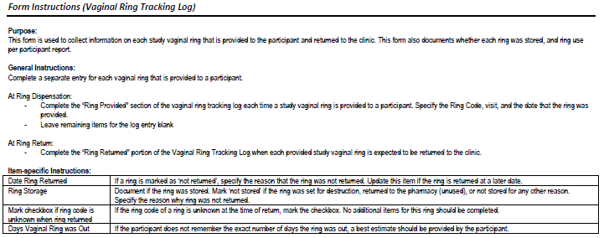

Slide 22
Used Ring Destruction Log
This log is completed to document destruction of the ring in specific biohazards waste container
Final documentation for used ring not destined for further testing
See HOPE website under Study Implementation Materials
Should be rare that a ring will be placed in container for destruction

Slide 23

Thank You!

